Slide 1
Data analysis on electromotive vehicles in Washington
Submited By:
Jugal Kishor
2210990467
Submited To:
Mr. Tushar khitoliya
Chitkara University Institute of Engineering and Technology (CUIET)
Chitkara University, Punjab

Slide 2

Outline
Introduction
Problem Statement
Motivation
Justification for Project
Objective
Methodology
Code snippets
References
Git Hub Repo: https://github.com/Jugal28k/Data-analysis-on-electromotive-vehicles-in-Washington

Slide 3
Introduction
Objective: By scrutinizing patterns, behaviours, and correlations within the electromotive vehicle landscape in washington, we aim to provide stakeholders with a roadmap for informed decision- making.
Importance of Electromobility :As the world transitions towards cleaner and more sustainable modes of transportation, electromobility emerges as a pivota solution to mitigate environmenta impacts,reduce dependence on fossil fuels and promote energy efficiency.
Harnessing Data and AI: Delving deep into the troves of data surrounding electromotive vehicles in washington. Harnessing this power of data - driven insights, we aim to unlock actionable strategies o propel the electromobility revolution forward.
Agenda: Throuout the presentation we will delve into various facets of electromobility data analysis including adoption trends.

Slide 4

Problem Statement
In the rapidly evolving landscape of transportation, the adoption of electromotive vehicles presents both opportunities and challenges. Within the context of washington state, the problem lies in understanding and optimizing the electromobility ecosystem to maximize its societal, environmental, and economic benefits.

Slide 5
Motivation
With the escalating concerns over climate change and air pollution, there’s a pressing need to transition towards cleaner and more sustainable modes of transportation.
Improve data accessibility by providing a tool for targeted information extraction.
Promoting equitable access to electromobility benefits all communities.

Slide 6
Justification for Project
Aligns with efforts to conserve the environment and preserve natural resources.
Facilitate targeted information retrieval, enhancing data accessibility for users.
The electromobility sector presents significant economic opportunities, including job creation, innovation, and investment.
We can provide policymakers with insights into adoption trends, infrastructure needs, regulatory frameworks, and policy interventions that sipport electromobility.

Slide 7
Objective
Analyze historical data to identify trends and patterns in the adoption of electromotive vehicles across different regions.
Assess the availability, accessibility, and utilization of charging infrastructure for electromotive vehicles.
Investing consumer attitudes, preferences, and behaviours towards electromotive vehicles.
Measure the environmental impact of electromotive vehicles, including reduction in greenhouse gas emissions, air pollutioins, and reliance on fossil fuels.

Slide 8
Methodology
Gather relevant datasets from multiple sources, including industry reports, academic studies, and private companies.
Cleanse and preprocess the collected data to ensure accuracy, consistency , and completeness.
Conduct exploratory data analysis to understand the characteristics and distribution of the data.
Apply machine learning and statistical modeling techniques to predict future trends, behaviours, and outcomes related to electromotive vehicles.

Slide 9
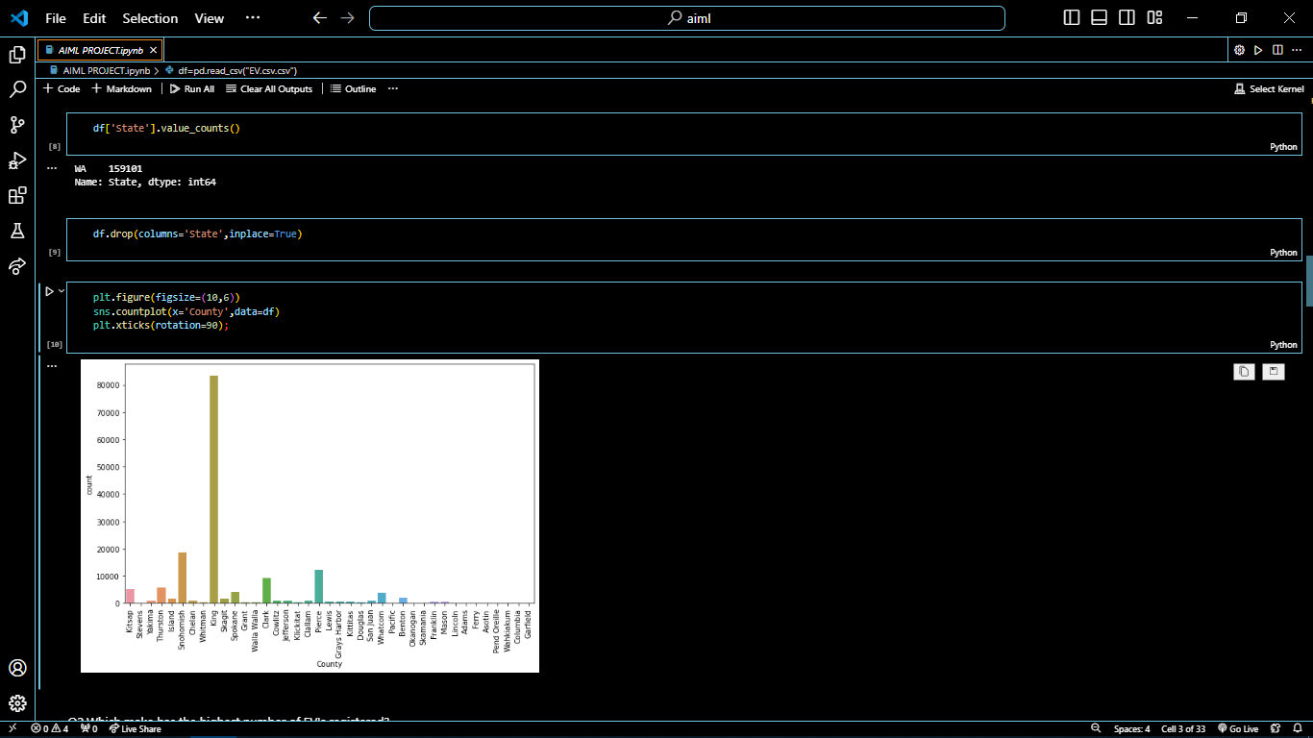
Code snippets

Slide 10
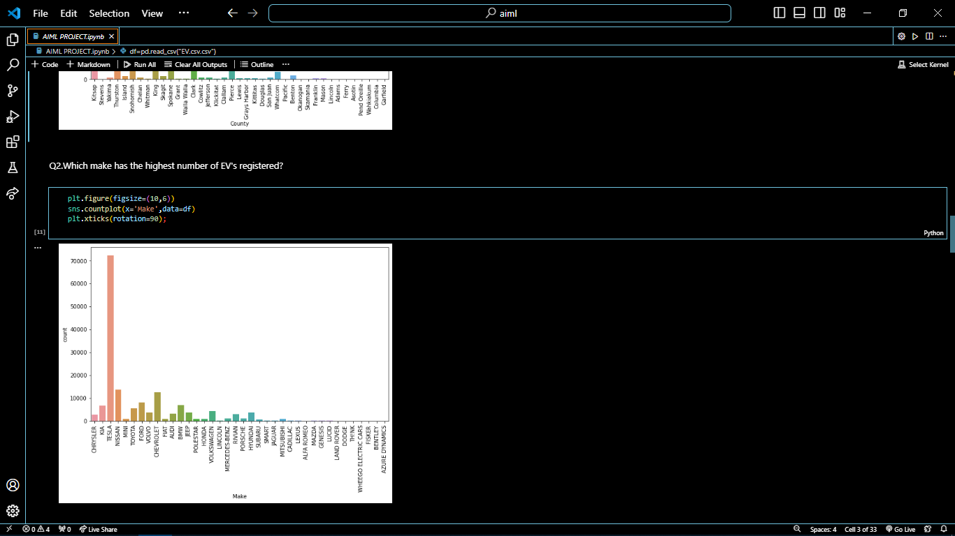
Code Snippets

Slide 11
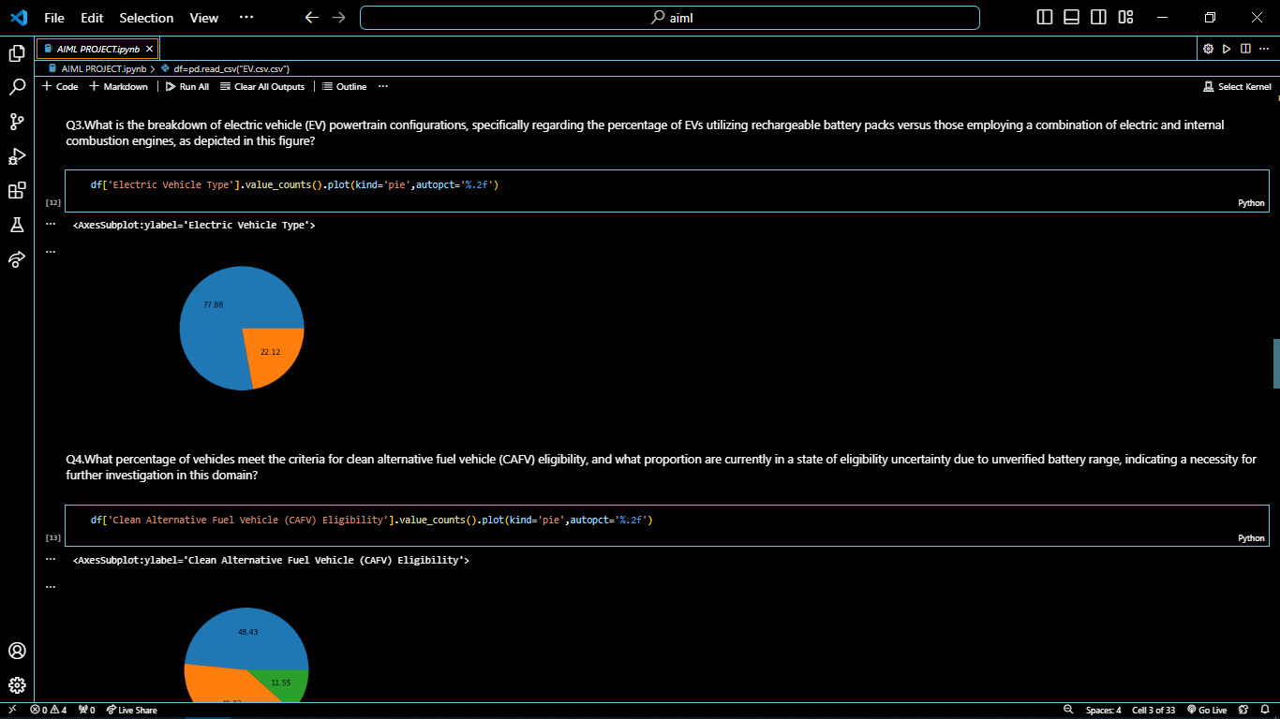
Code snippet

Slide 12
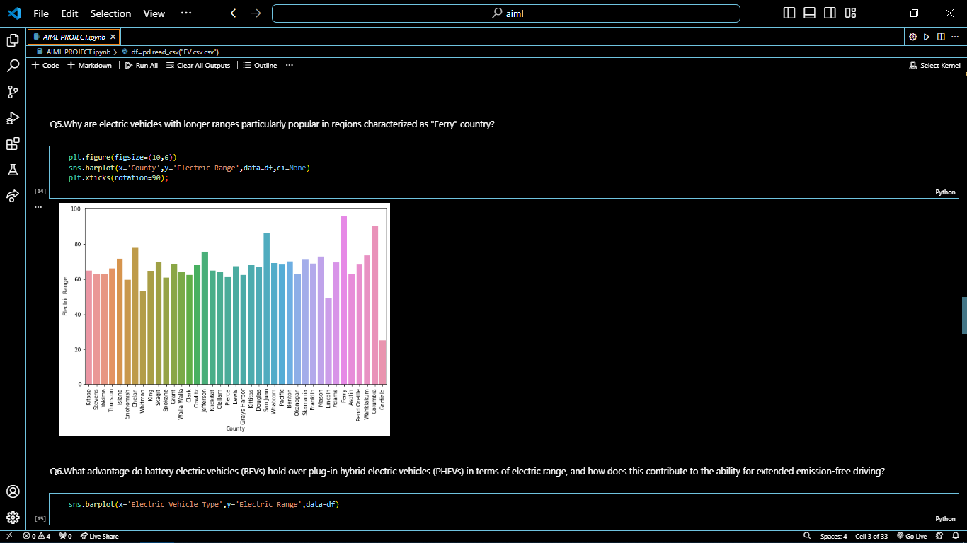
Code snippet

Slide 13
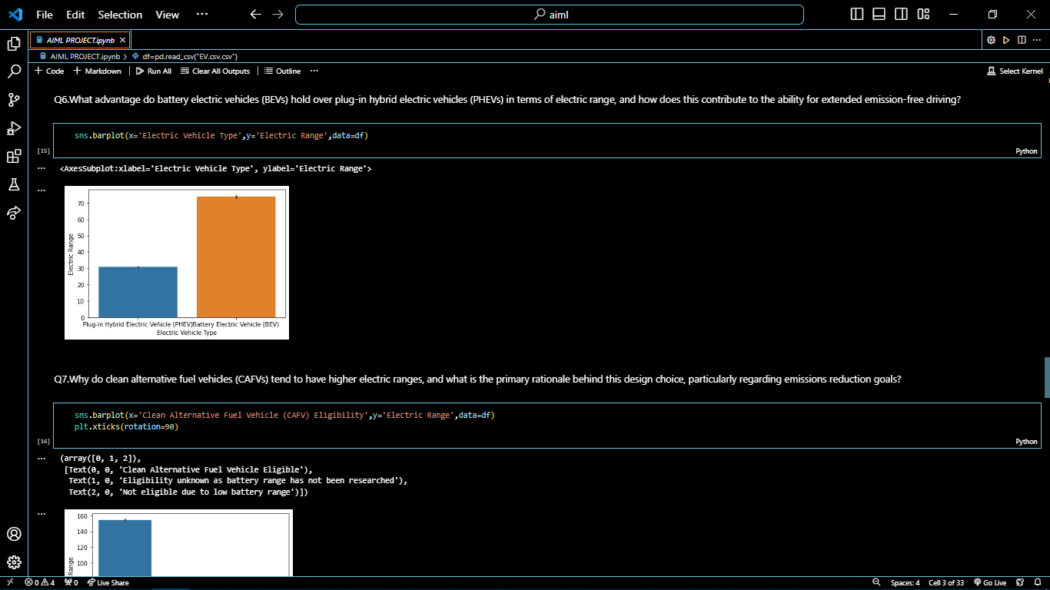
Code Snippet

Slide 14
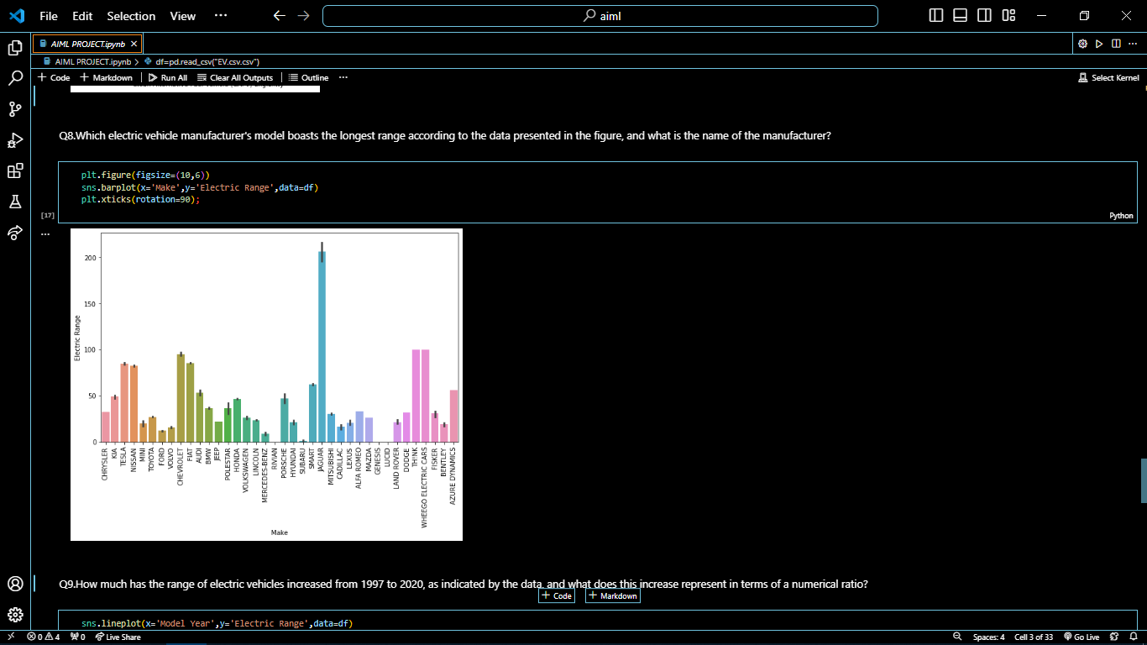
Code Snippet

Slide 15
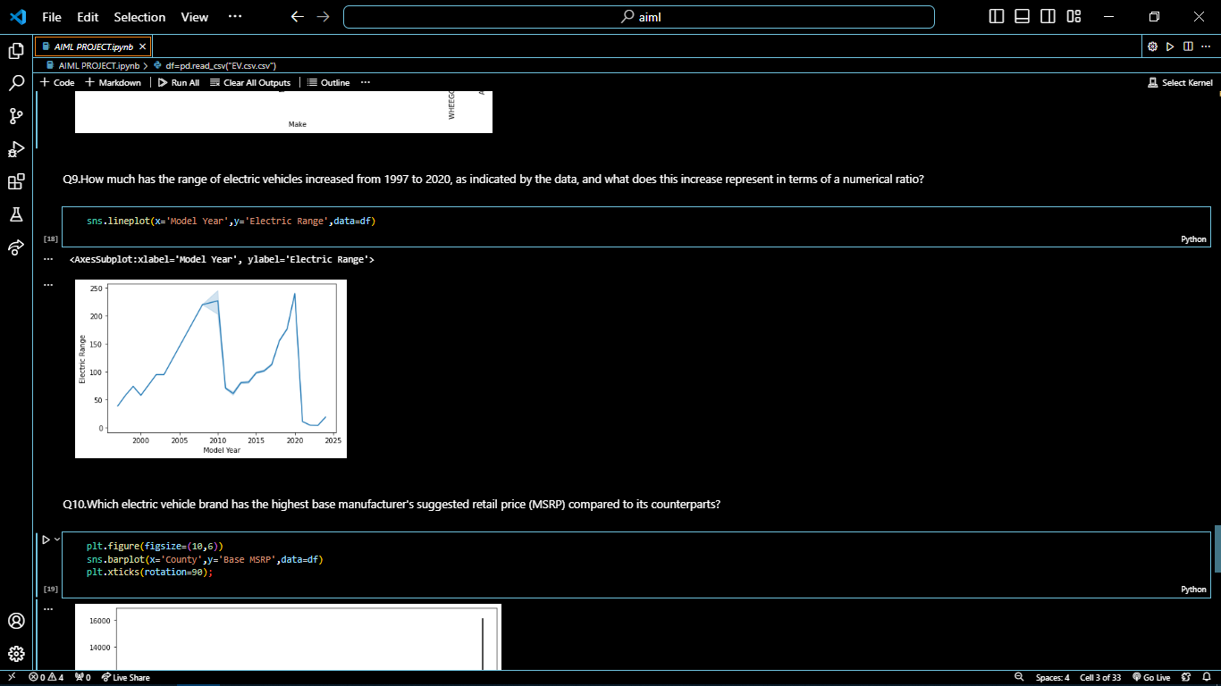
Code Snippet

Slide 16
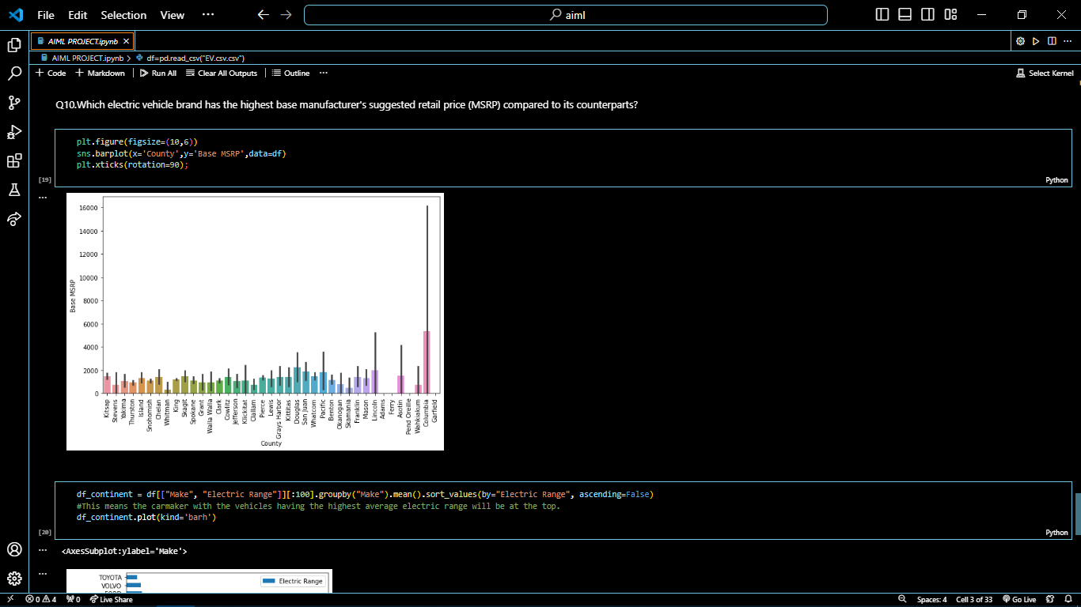
Code Snippet

Slide 17
References
GeeksForGeeks
https://www.geeksforgeeks.org/
Youtube
https://www.youtube.com/
Python Documentation
https://docs.python.org/3/
Wikipedia
https://en.wikipedia.org/wiki/Morse_code

Slide 18
Thank You

